Slide 1


ADVANCED JAVA PROJECT - SHOPPING CART
SHANELLE HAYE

Slide 2
OBJECTIVE
Create a shopping cart site including:
Home Page
Features a slider with product images
Products Page
Lists all products
Can select a product and view on a separate page
Orders Page
Lists all completed orders
Shopping Cart
User can view the items in their cart, adjust the quantity, add or remove and they can complete the checkout process
Login
User can log in or create an account
Log Out
User can log out
Contact Us
Features the company’s contact info and a form the user can fill out to send a message
About Us
Brief paragraph about the company

Slide 3

TOOLS
ECLIPSE
JAVA
JSP
MYSQL
DAO
SERVLETS

Slide 4
User Flow
Home Page
Shopping Cart
Orders
Login
Log Out
About Us
Contact Us

Slide 5
UML DIAGRAM
UserDoa
+ createUser()
+ getUser()
+ updateUser()
+ deleteUser()
ProductDoa
+ getSingleProduct()
+ getTotalCartPrice()
+ getCartProducts()
+ getAllProducts()
OrderDoa
+ insertOrder()
+ userOrders()
+ cancelOrder ()
+ updateOrder()
Cart
- items: List<CartItem>
+ addToCart()
+ removeFromCart()
+ clearCart()
About Us
- images: Image[]
- paragraphs: String[]
+ setImages(images: Image[]): void
+ setParagraphs(paragraphs: String[]): void
User - Class
- userId: int
- username: String
- password: Strin
- email: String
- role: UserRole
Product - Class
- productId: int
- name: String
- category: String
- price: double
Order - Class
- orderId: int
- userId: int
- status: OrderStatus
- date: String
- items: List<CartItem>
Cart - Class
- productId: int
- quantity: int
- price: double
Contact Us
- contactForm: Form
+ setContactForm(form: Form): void

Slide 6
DATABASE DIAGRAM
Orders
- OrderID PK
- PurchaseID
- UserID FK
- OrderQuantity
- OrderDate
Users
- UserID PK
- Name
- Email
- Password
Products
- ProductID PK
- Name
- CategoryID FK
- Price
- Image
Categorgies
- CategoryID PK
- Name
- Category
Messages
- MessageID PK
- Name
- Email
- Password

Slide 7
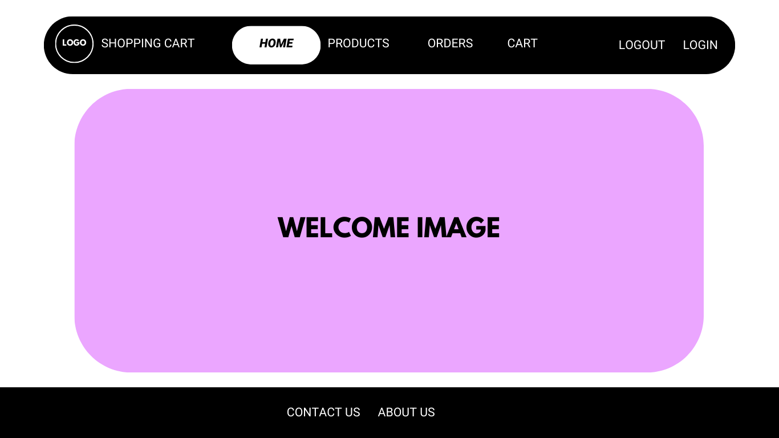
Home Page

Slide 8
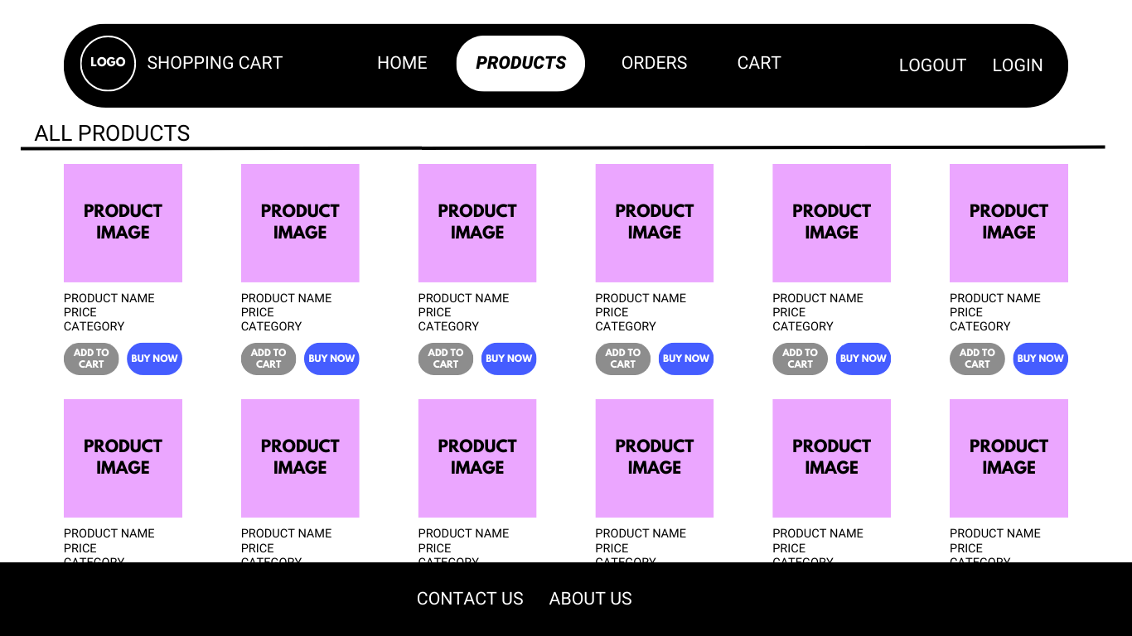
Home Page

Slide 9
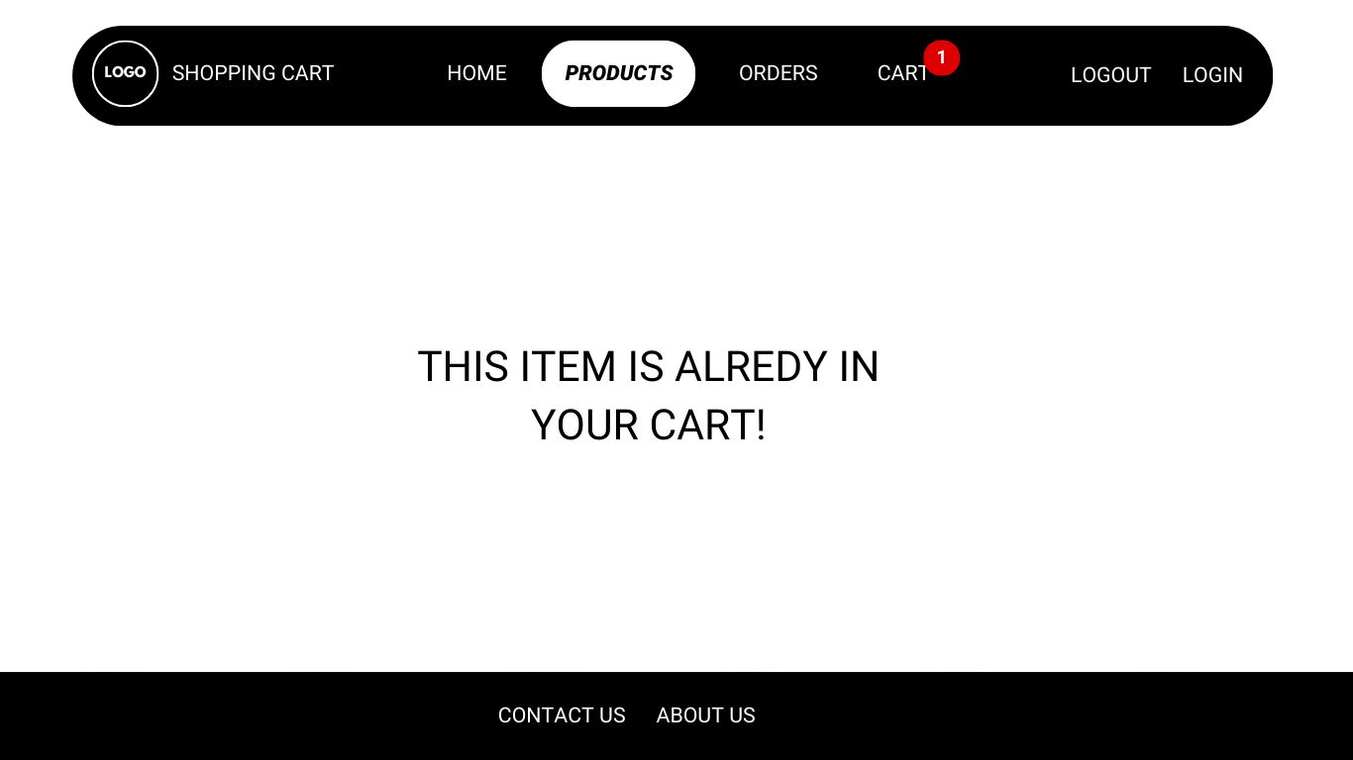
Item Already In Cart

Slide 10
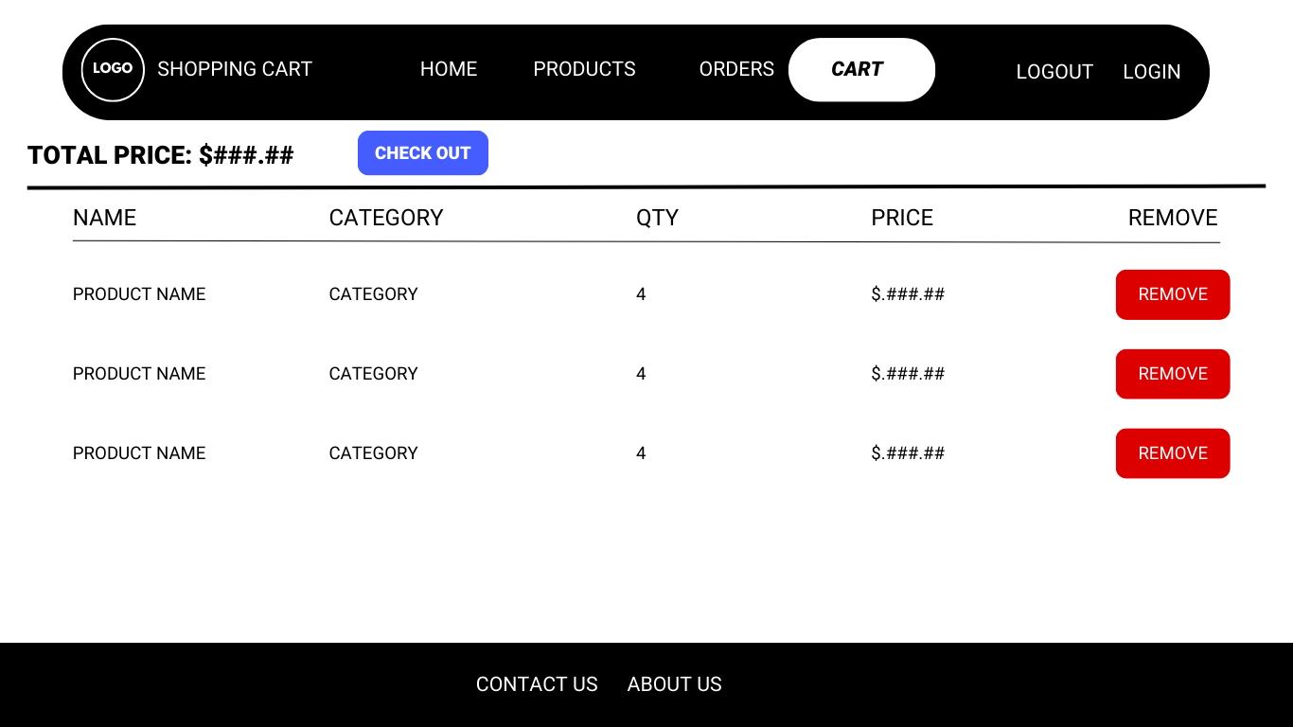
Shopping Cart Page

Slide 11
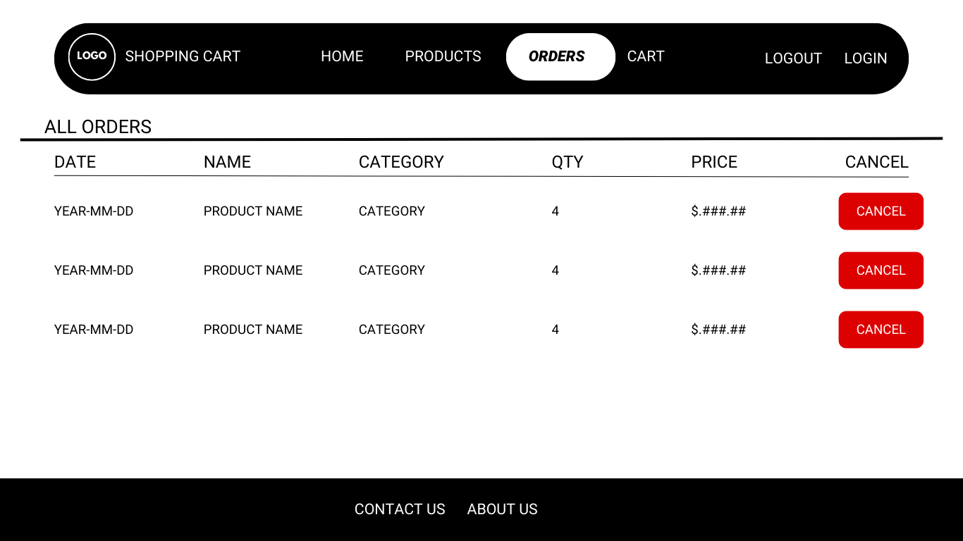
Orders Page

Slide 12
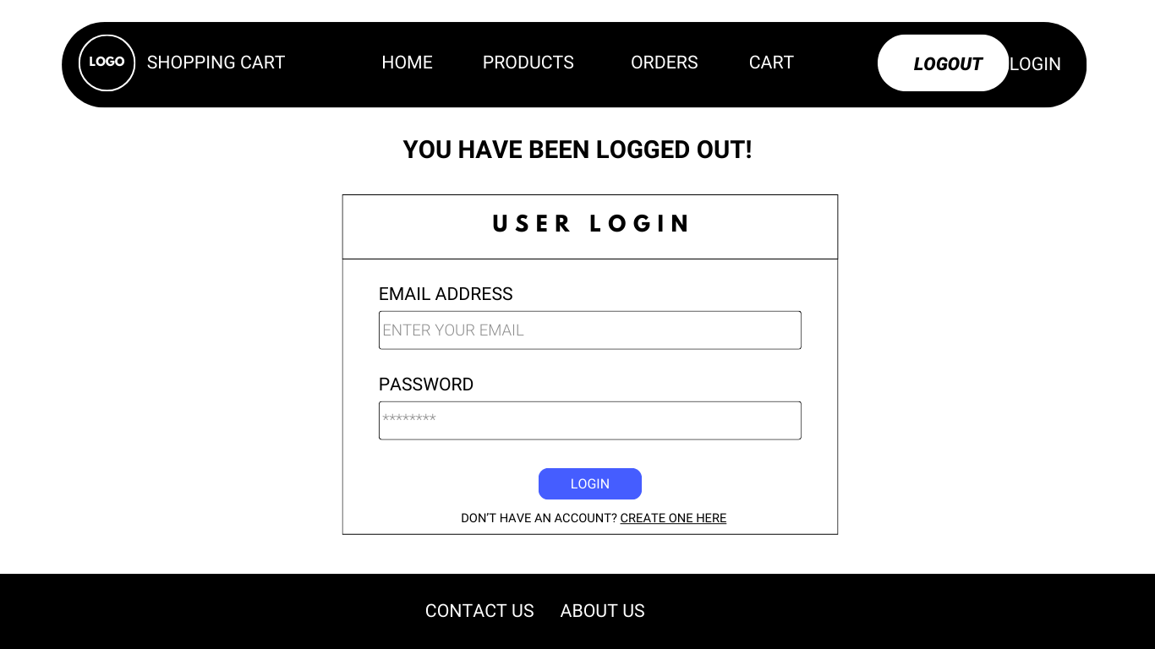
Login Page

Slide 13
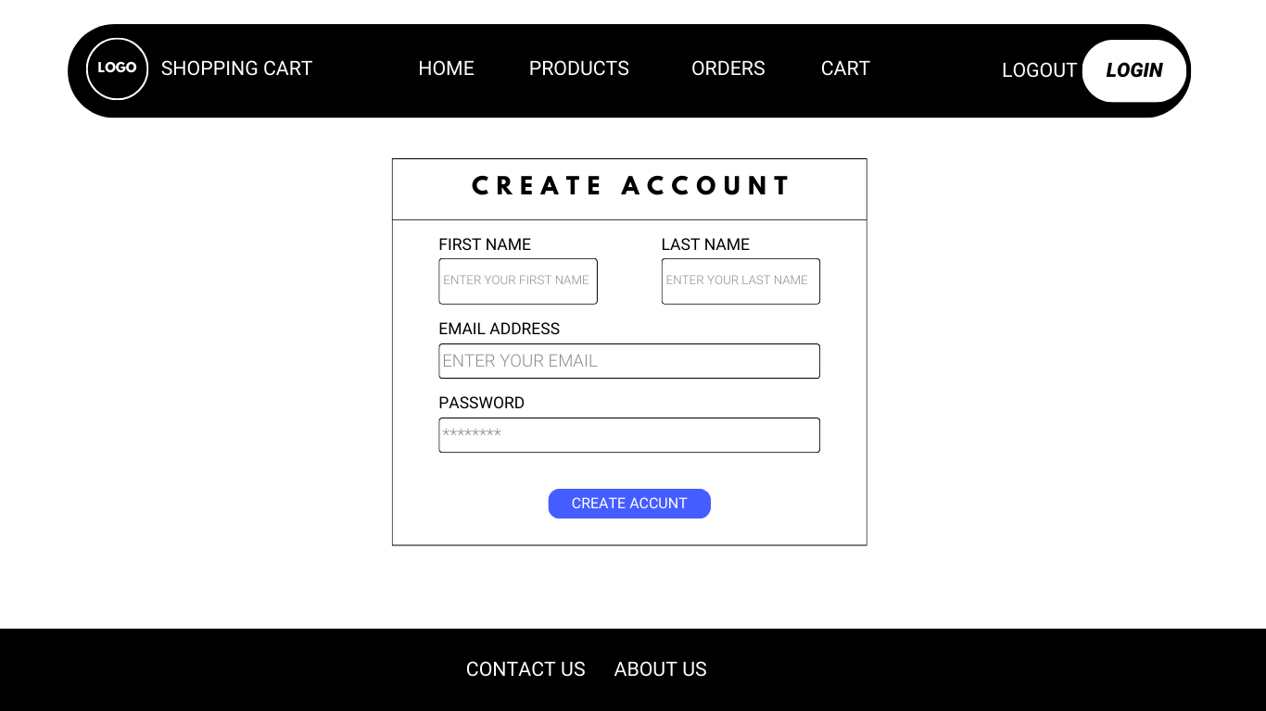
Create Account

Slide 14
Logout Page

Slide 15
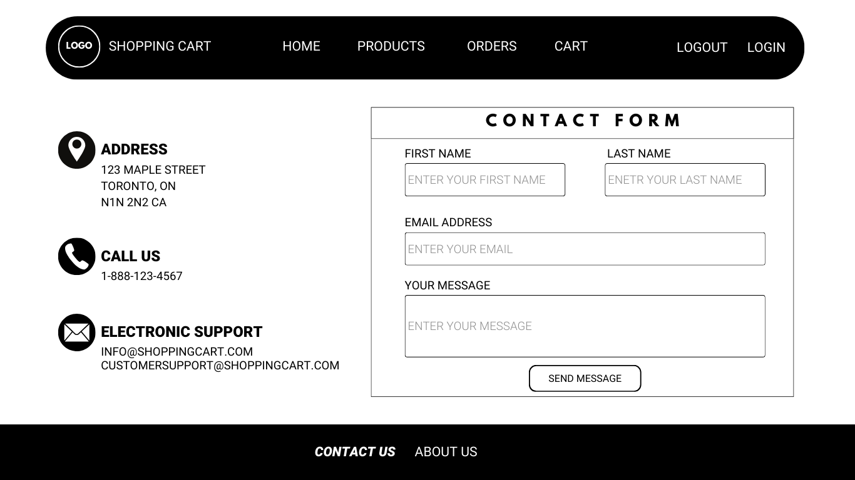
Contact Us Page

Slide 16
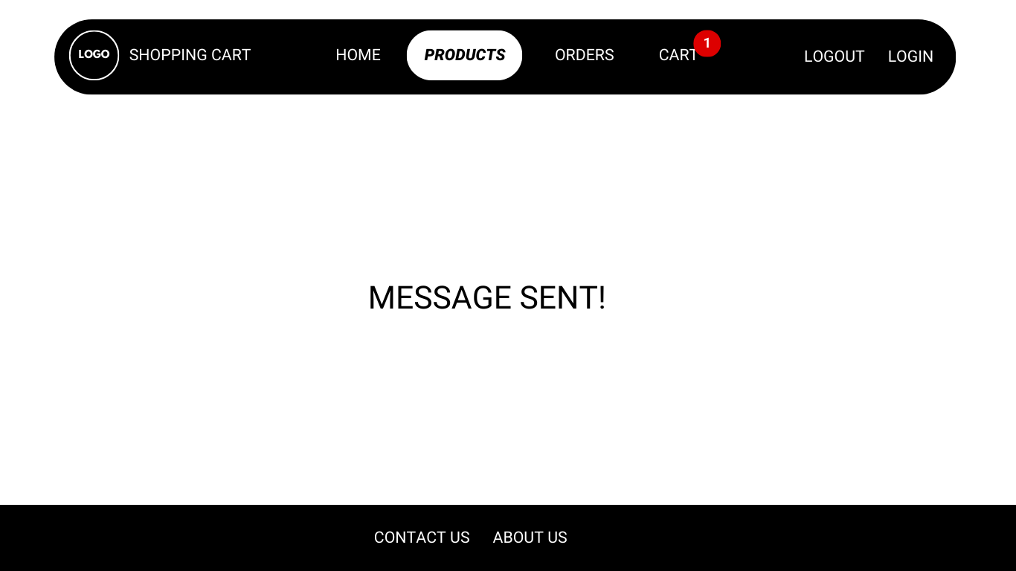
Message Sent

Slide 17
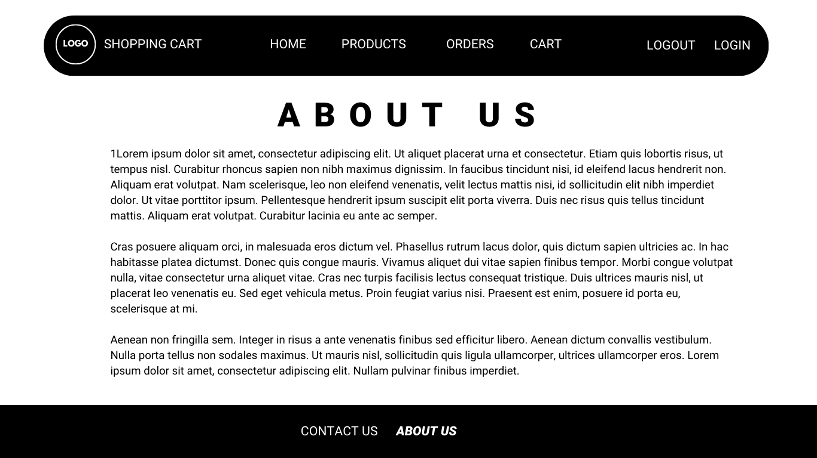
About Us Page

Slide 18
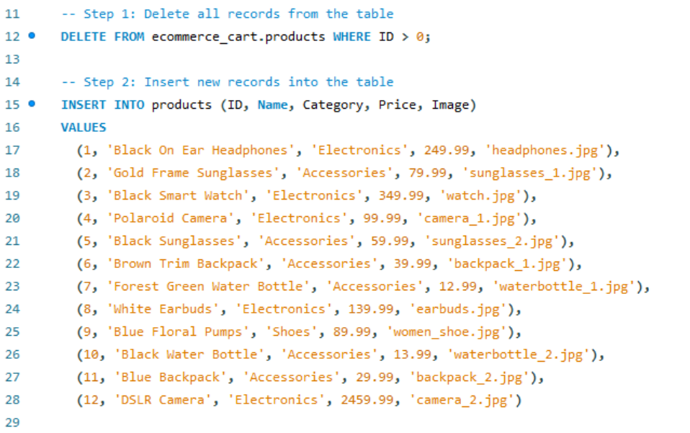
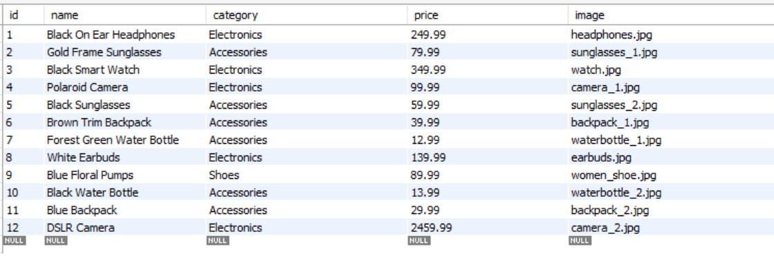
Screenshots

Slide 19
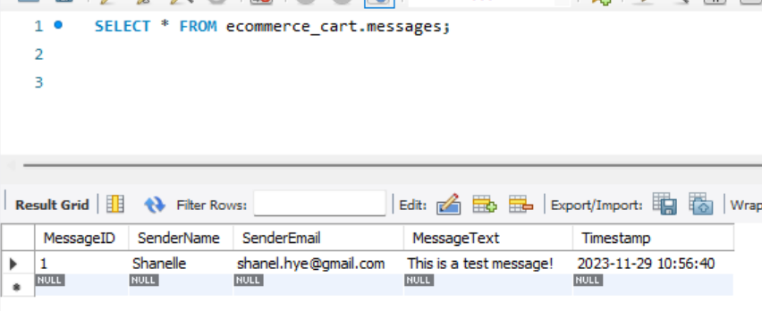
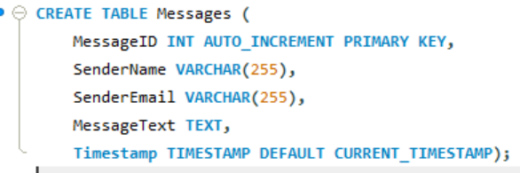
Screenshots

Slide 20
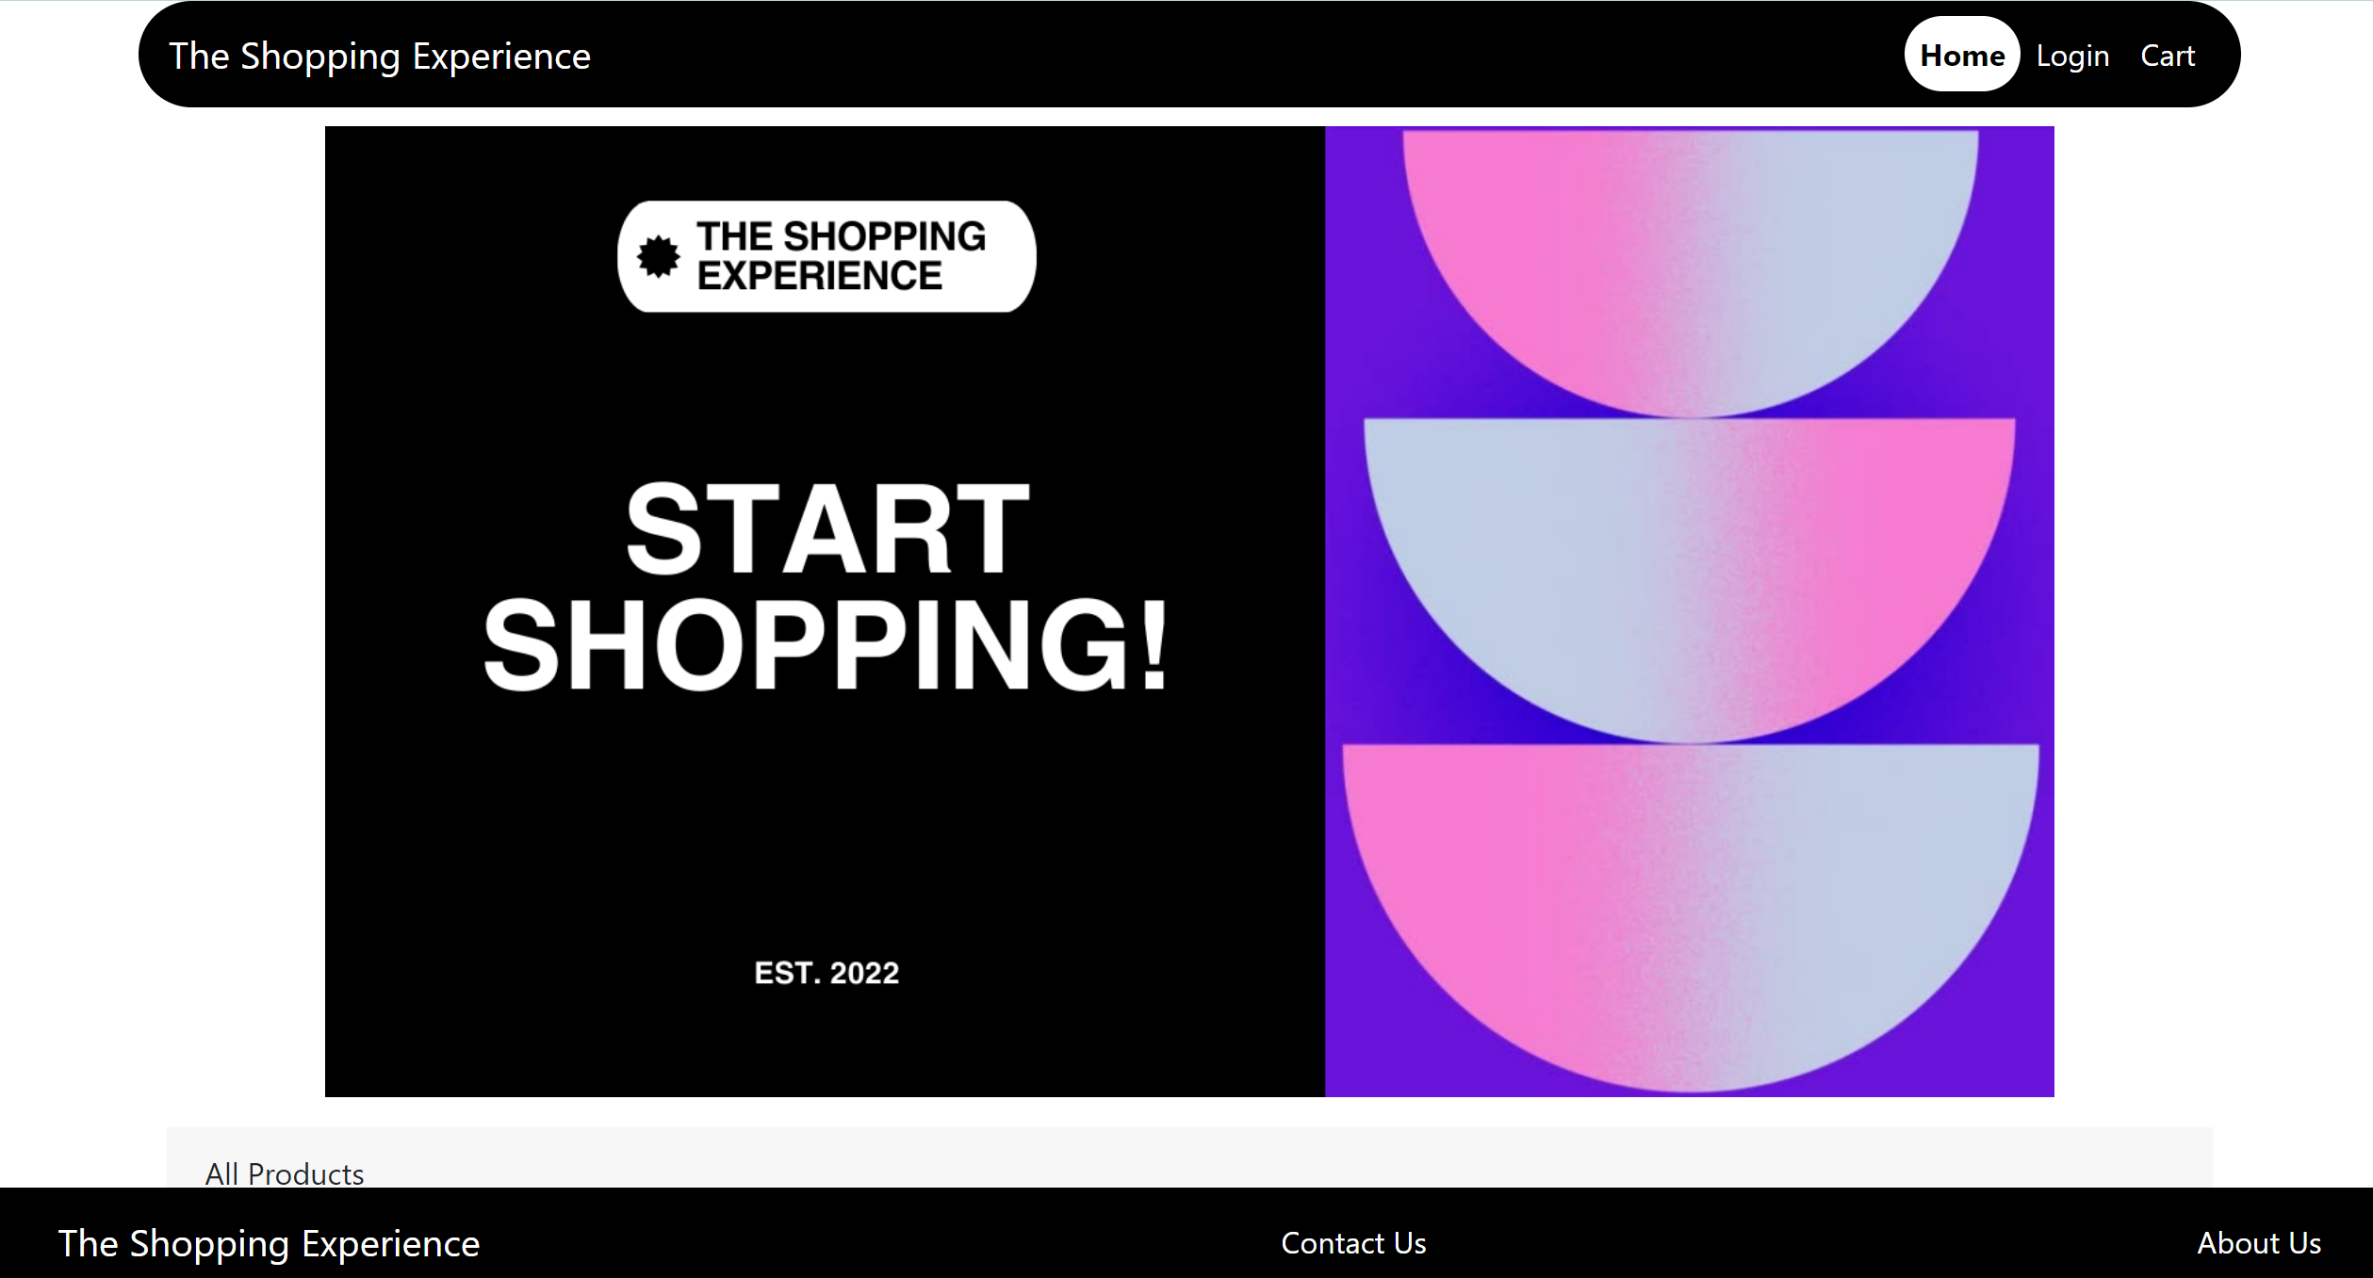
Screenshots
HOME PAGE

Slide 21
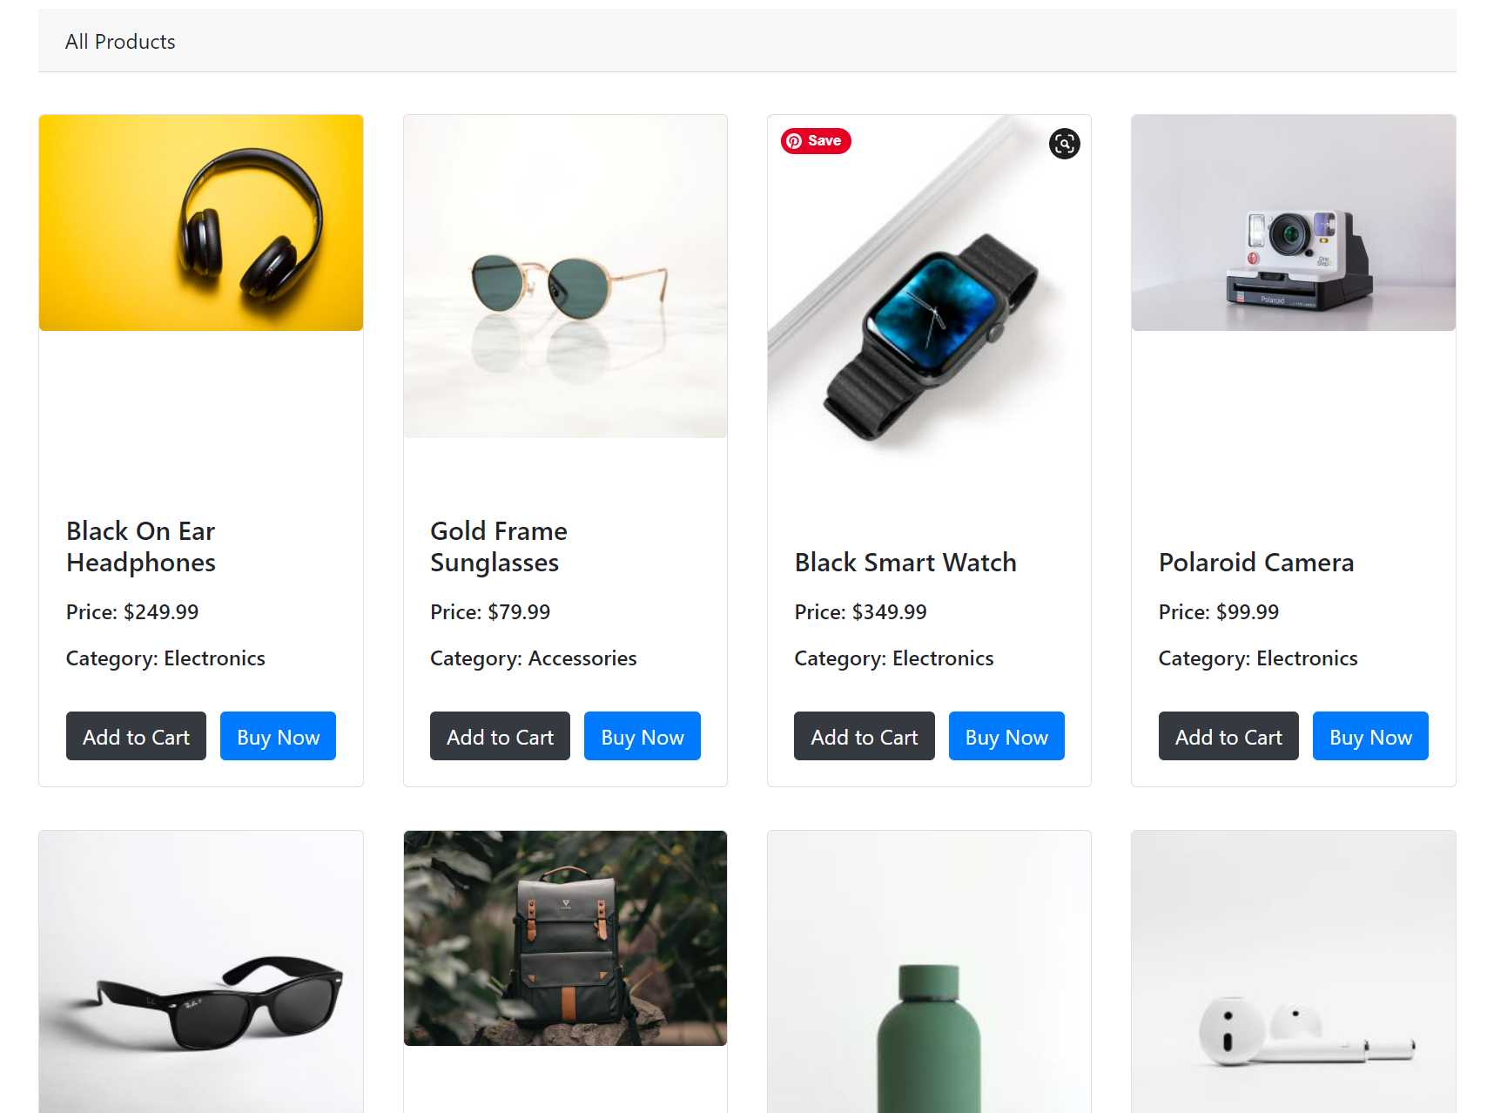
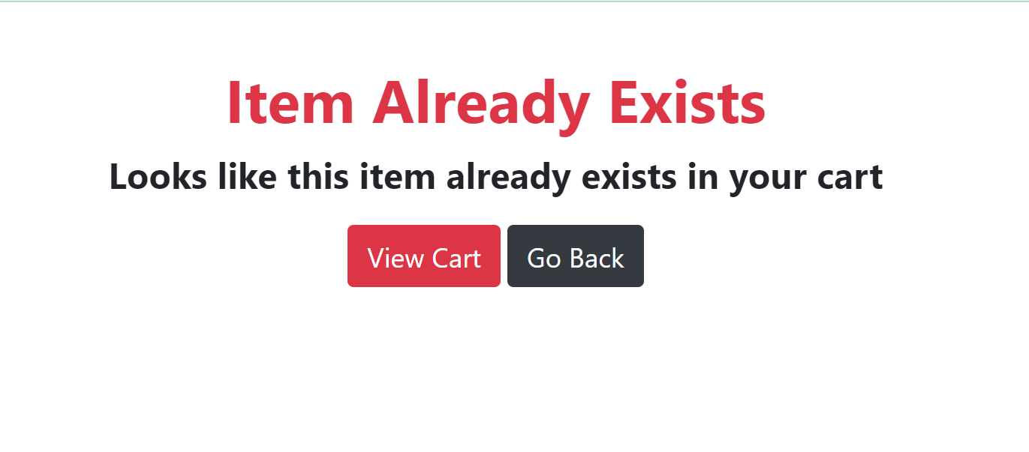
Screenshots
HOME PAGE CONTINUED…

Slide 22
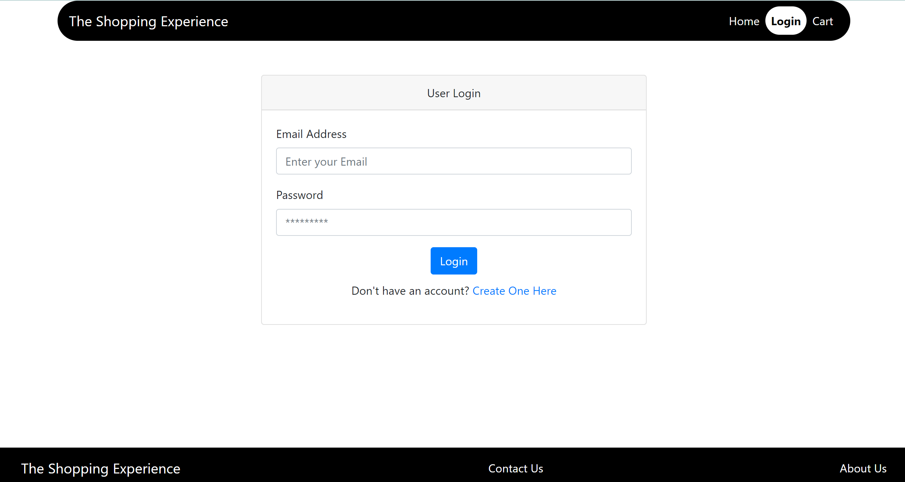
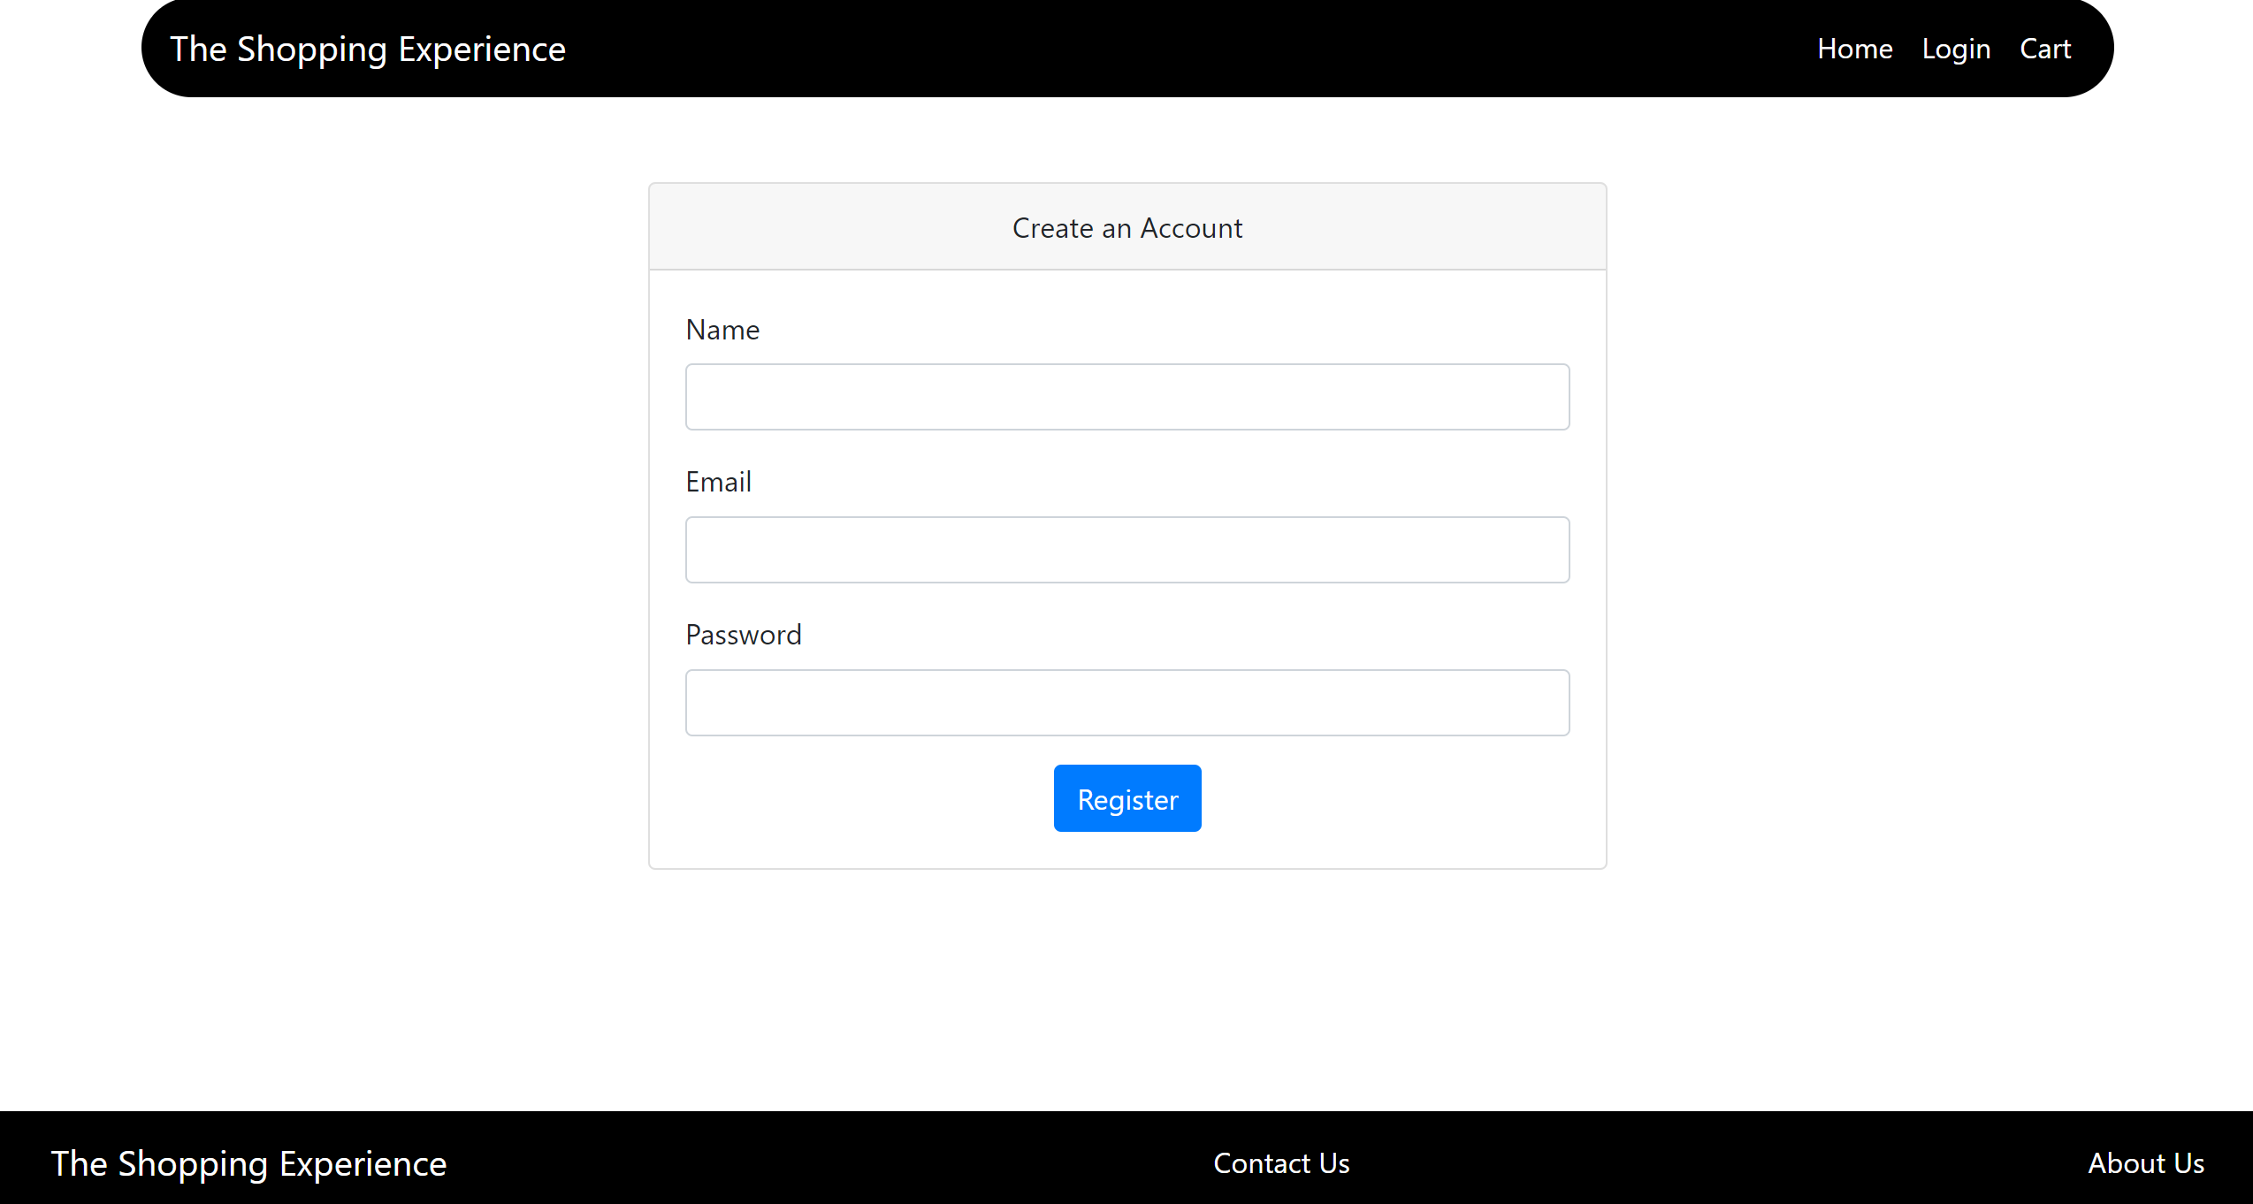
Screenshots
LOGIN
CREATE ACCOUNT

Slide 23
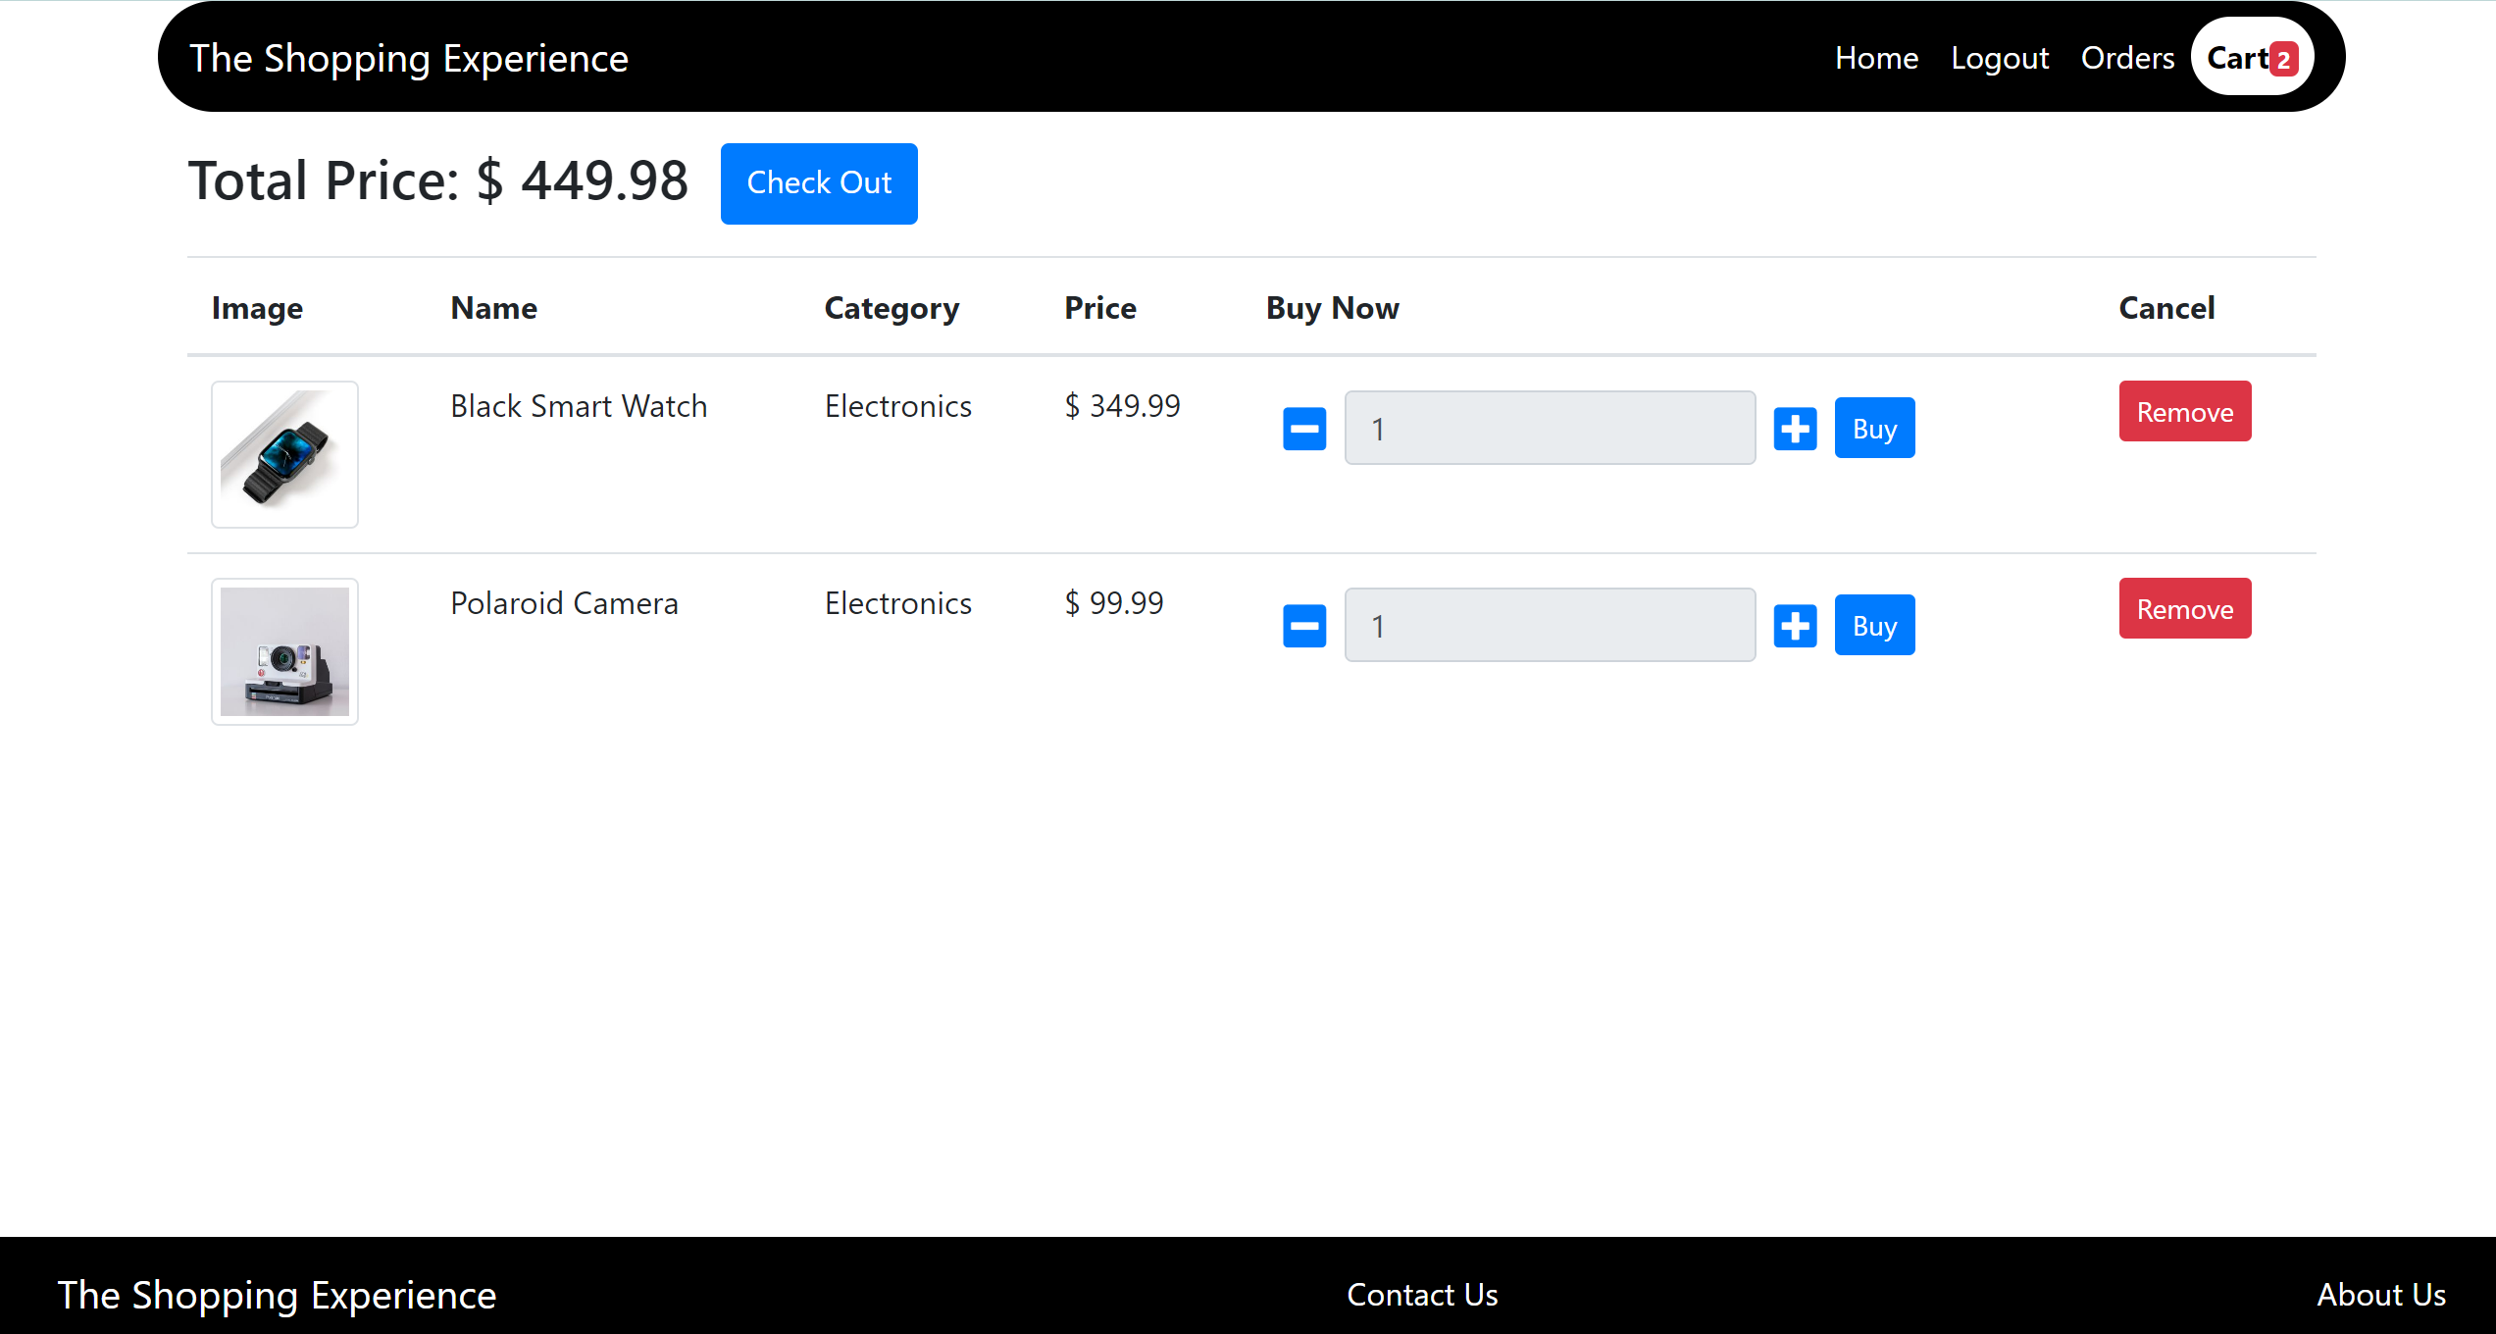
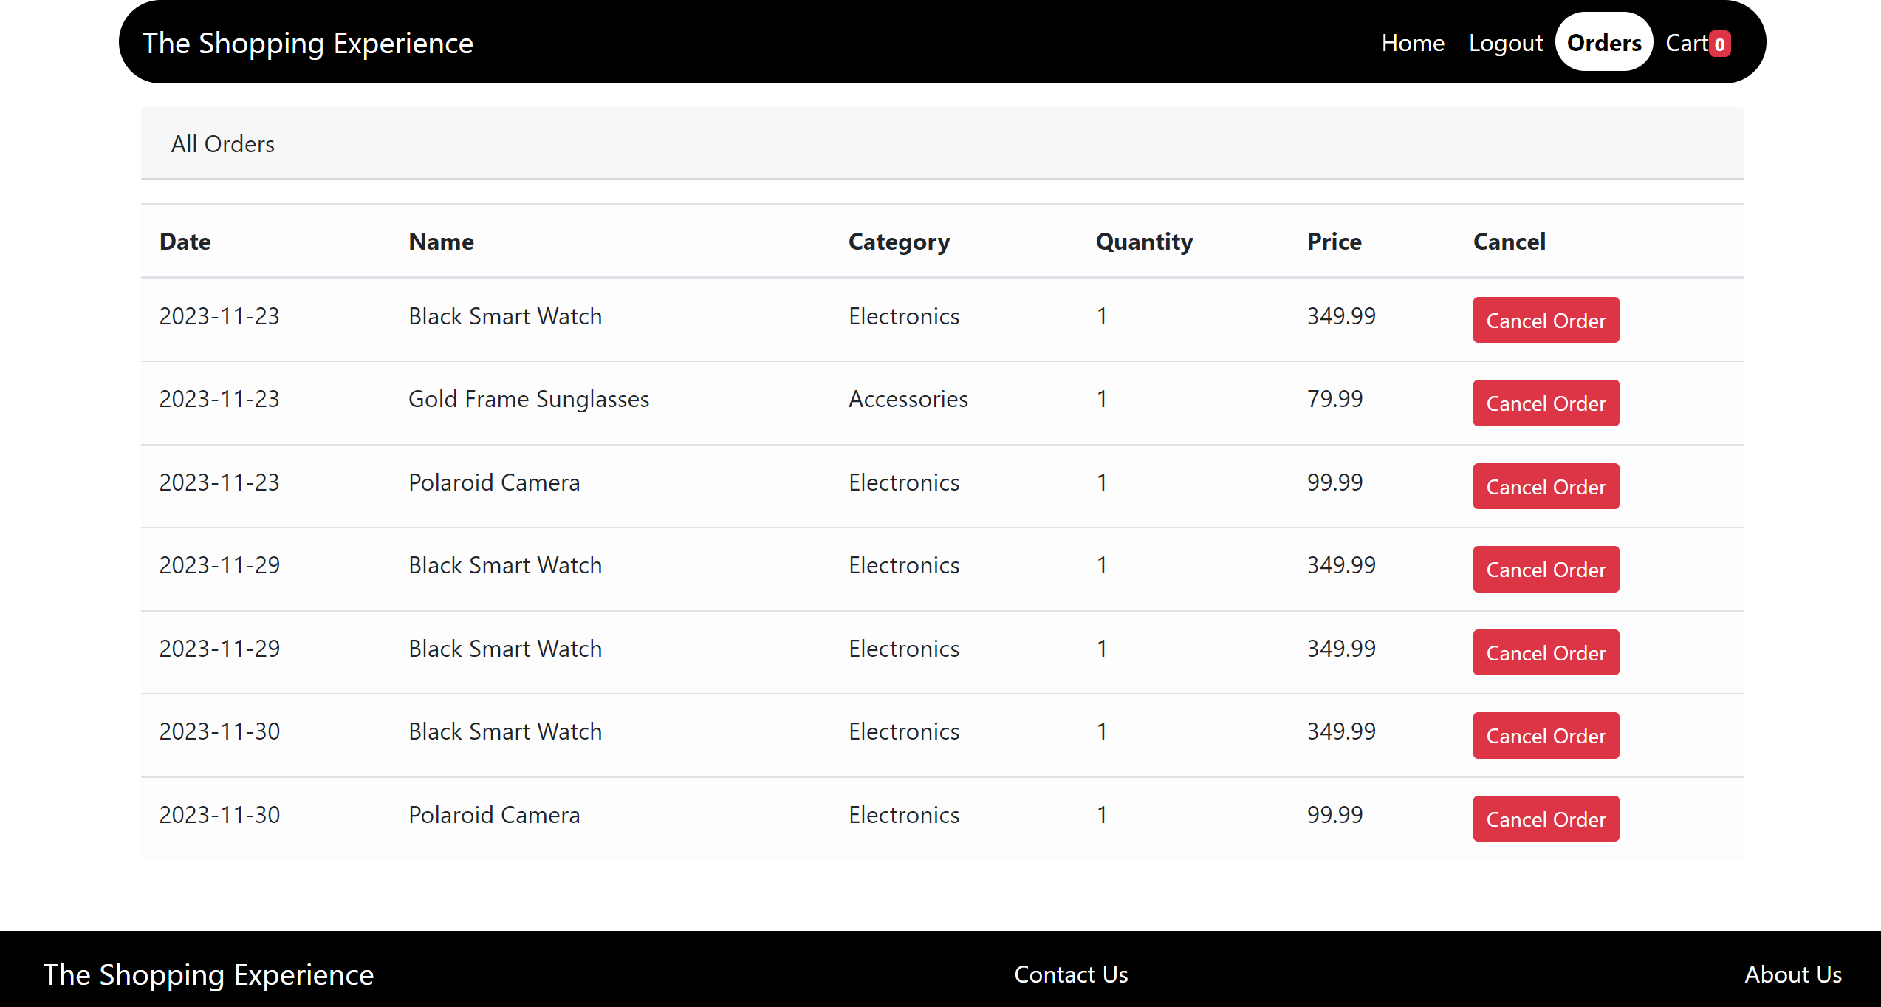
Screenshots
SHOPPING CART
ORDERS PAGE

Slide 24
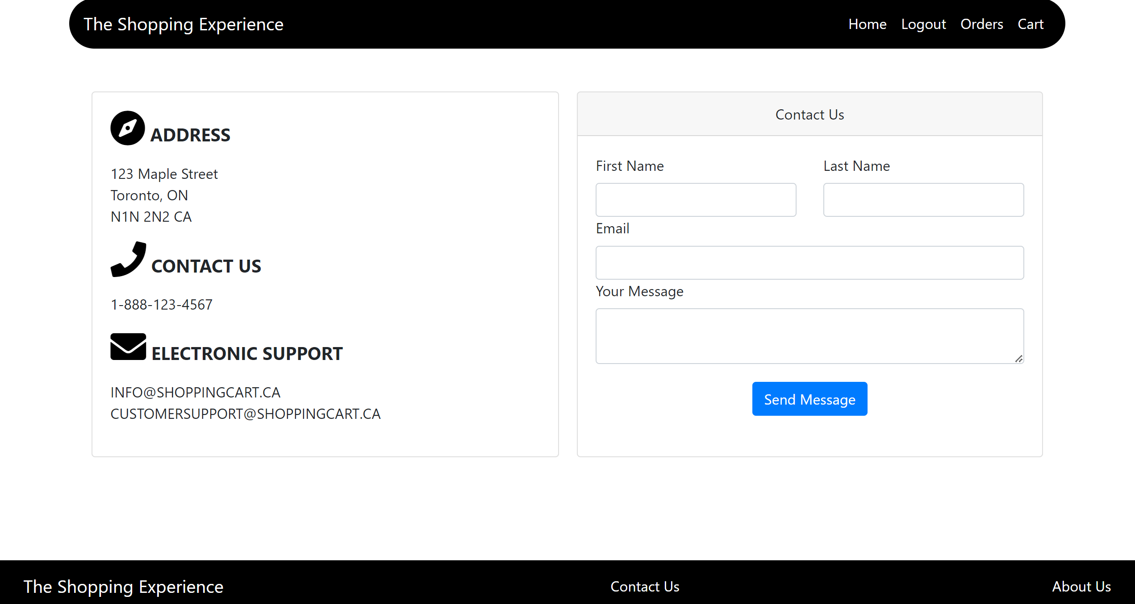
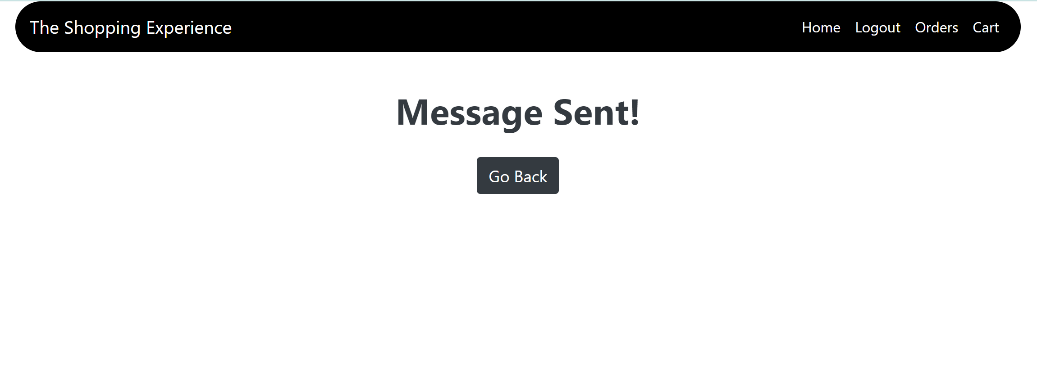
Screenshots
CONTACT US
MESSAGE SUCCCESS MESSAGE

Slide 25
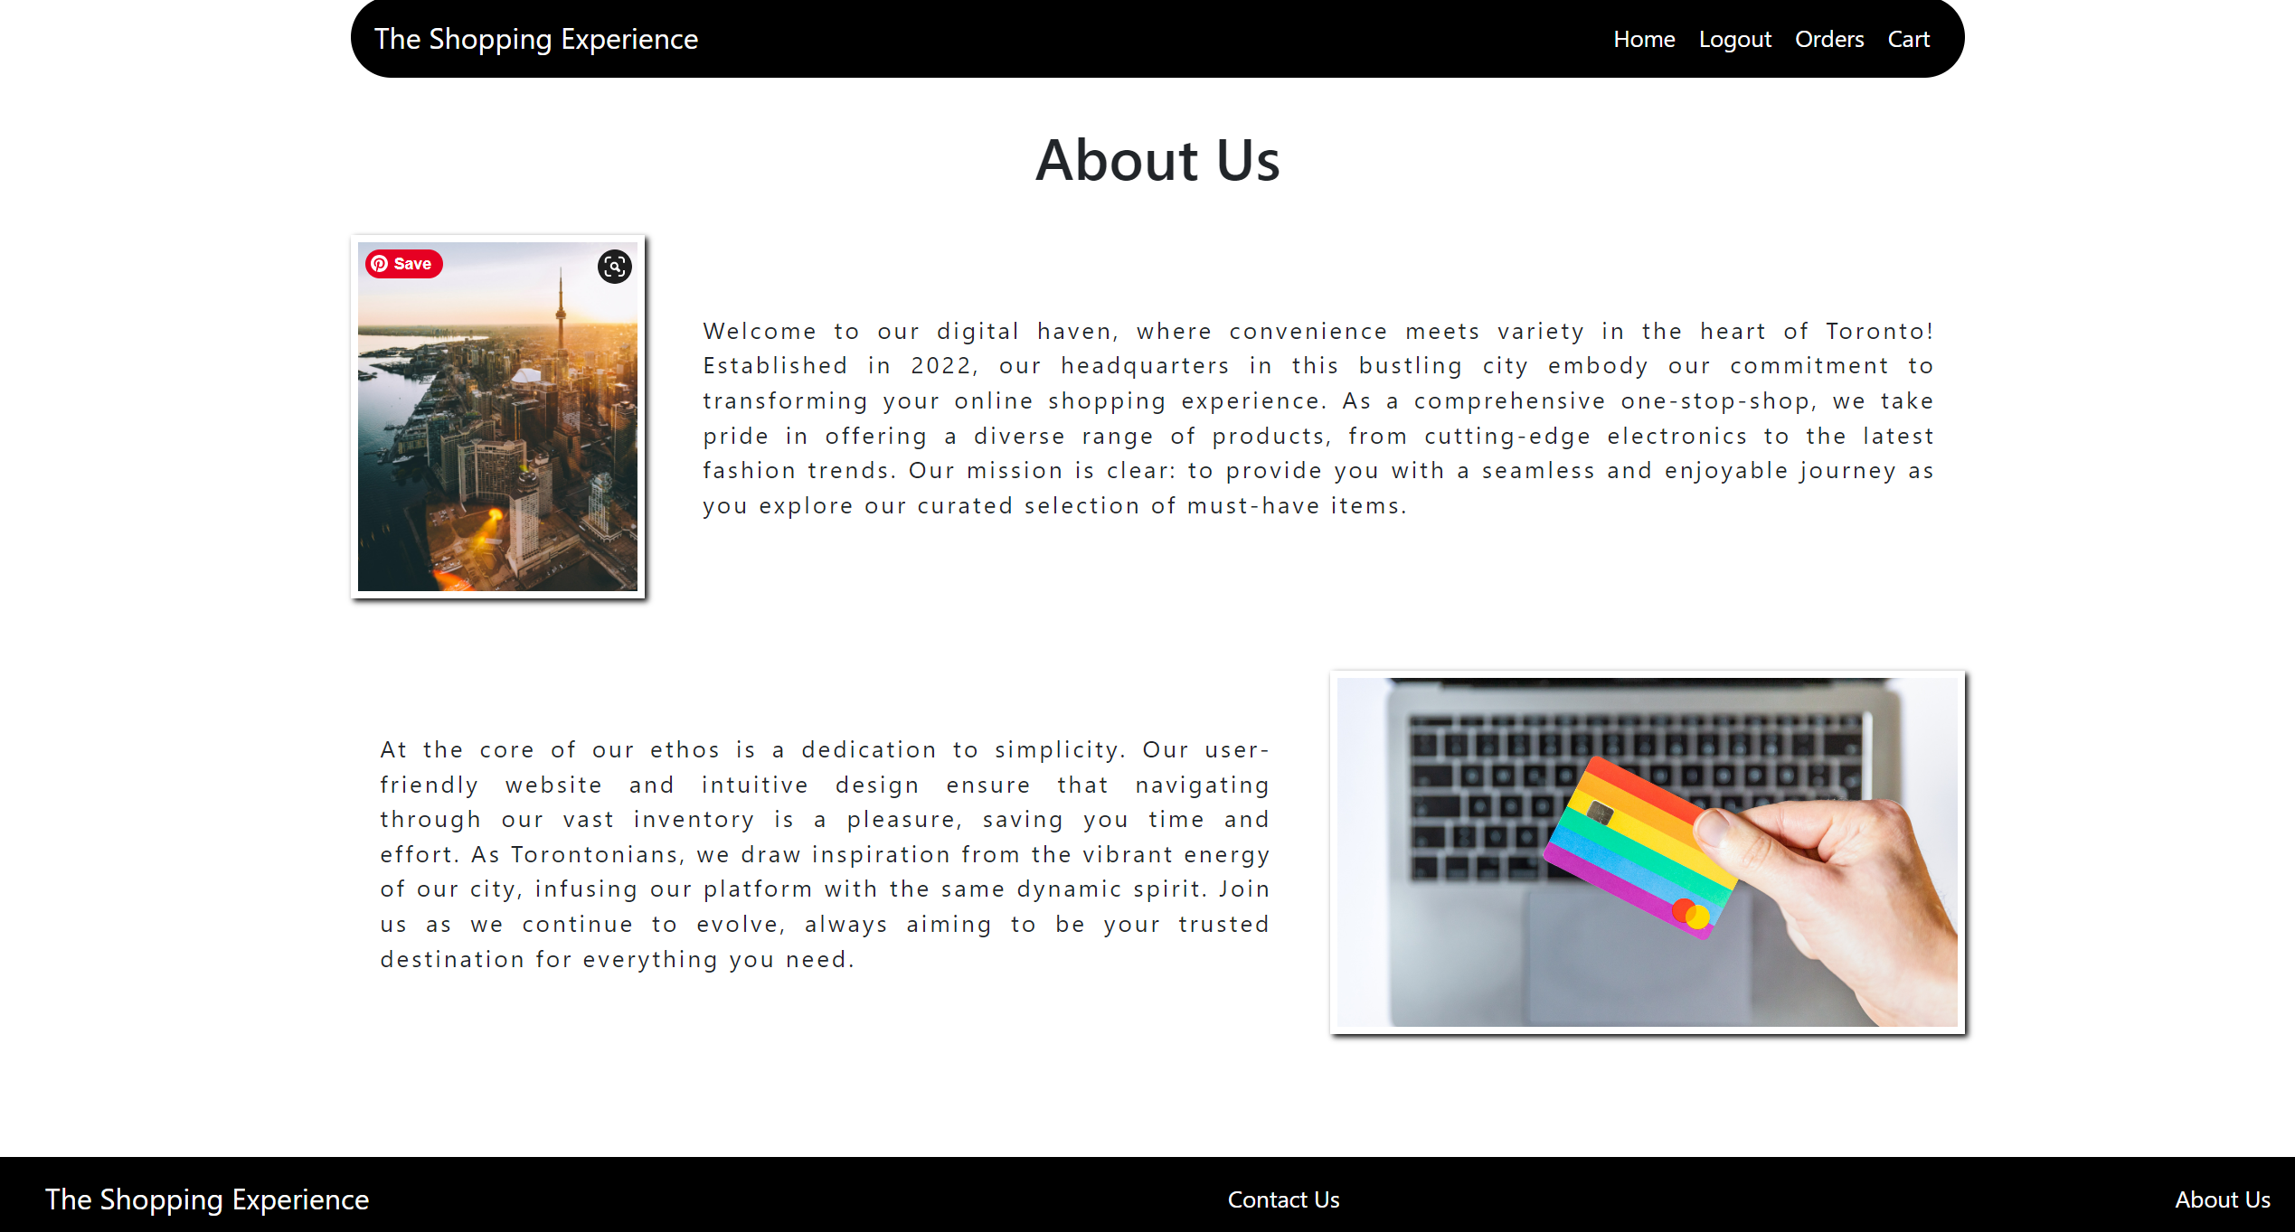
Screenshots
ABOUT US

